Slide 1
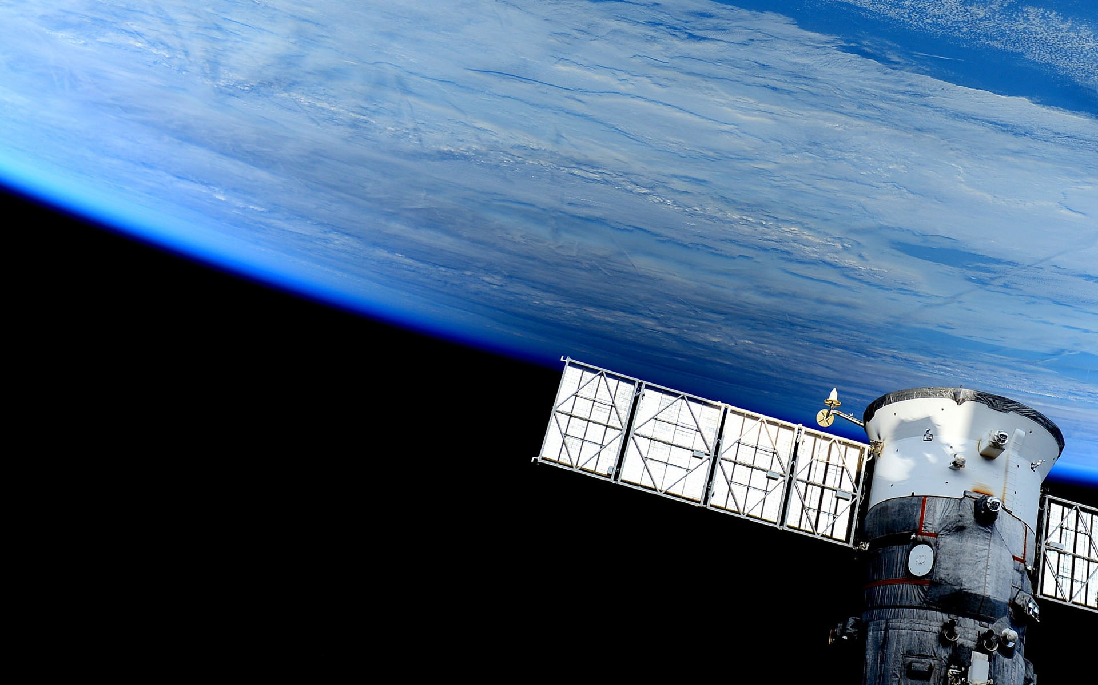

Batteries Tester
Blanca Cano Camarero
Javier Germán Luzón Hidalgo
Miguel Romero García

Slide 2
Index

Slide 3
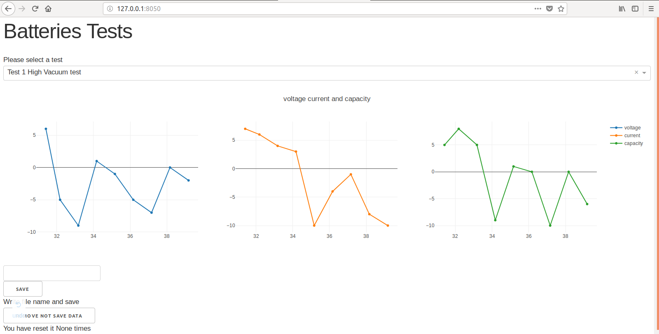
First functional interface
We have finished web page server.
Let have a direct prove:
Host and port direction
Dropdown to select test data
Change display data
Inbox to introduce data file name
Zoom in /zoom out.
Move inside
Download plot as png
Remove recollect data

Slide 4
Interface and web application
Problems and solutions
Interface design: dash library
Data save:
  Problems:Unkonw data size,physical limits, memory.
  Solutions:
    Use danque, special limited python list.
    Hide file .Test.csv managed by shell’s comands in window and linux to save all data.

Slide 5


Remote control
vs
First approach: Rasberry pi control
Dietpi rasberry

